Slide 1

Intro to
Programming
With python
iteration:
while loops
Friday, April 25 2025 TOH210
Notes:
Layout objects pulled from: https://slidesgo.com/
All icons are from: https://thenounproject.com/

Slide 2

While
Workbook
click for access
found on Moodle under this week

Slide 3

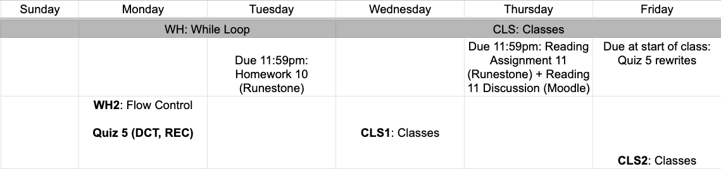
upcoming week
google sheet link
Notes:
https://docs.google.com/forms/d/e/1FAIpQLSe3OloPAJSid4n6cyU_4qXpRWU7FOSmP7IVdRS_vh9cvYd9zQ/viewform?usp=sharing

Slide 4
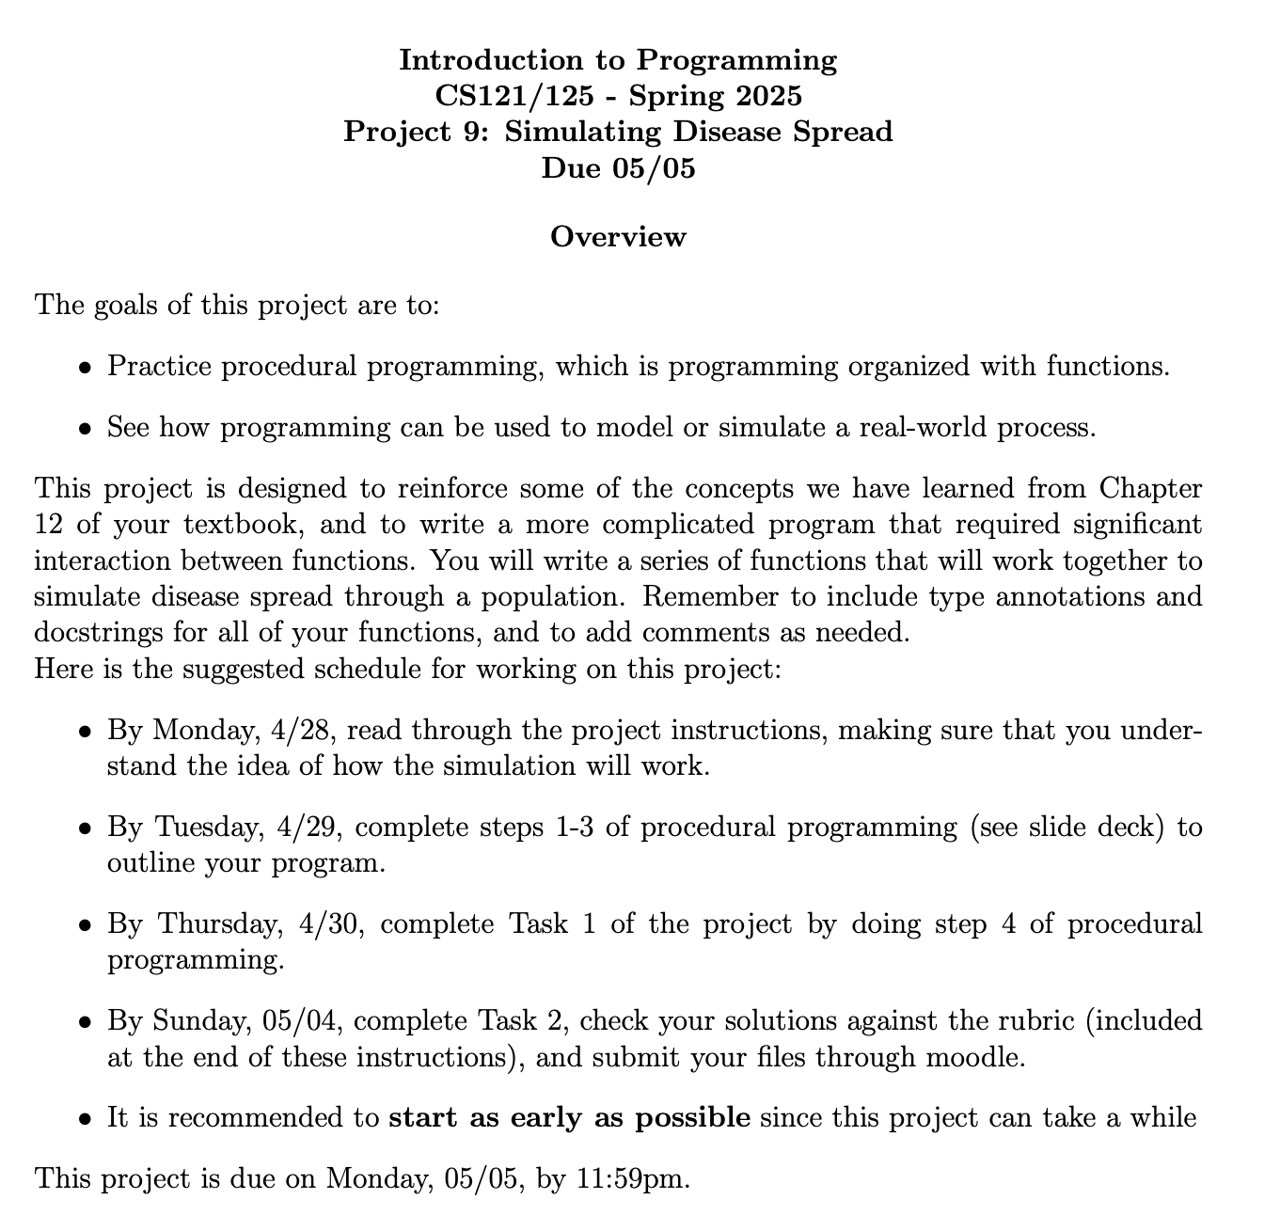
Project 9

Slide 5
Takeaways from last time
pros/cons of recursion
recursion practice

Slide 6


WARMUP
Recursive sequence
Consider the sequence of numbers defined by:
X0 = 2 and Xn=0.5*Xn+1
Then we have:
X0 = 2
X1 = 0.5*X2 = 4
X2 = 0.5*X3 = 8
X3 = 0.5*X4 = 16
Define a recursive function x_seq that takes an integer n as an argument, and returns the value Xn.
Remember, you’ll have to rewrite something to make this recursive!
Xn=2*Xn-1
X1=2*X0
X2=2*X1
X3=2*X2

Slide 7
Suppose we want to write a program that plays a guessing game with the user. The program keeps asking the user to guess a number, until the user
gets it correct.
Guess a number: 7
Incorrect. Guess another: 99
Incorrect. Guess another: -123
Incorrect. Guess another: 42
Yay! You guessed correctly!
Using what we have covered so far, how would we go about implementing this?

Slide 8
add the following code to your colab workbook under Example: Guessing Game
We can use a while loop to repeat code until a condition is no longer met
#user guesses a number
number = int(input(“Guess a number: ”)
#continue to guess until it’s correct
while number != 42:
number = int(input(“Guess a number: ”)
#if they guess correctly, let them know
print(“Yay! You guessed correctly!”)

Slide 9
Let’s look at the general flow of a while loop
while condition:
do something
True
evaluate condition
continue loop
False
resume program
after loop

Slide 10
Let’s look at the flow of the while loop from our guessing game example
number = int(input(“Guess a number: ”)
user enters number
while number != 42:
number = int(input(“Guess a number: ”)
print(“Yay! You guessed correctly!”)
evaluate number!=42
False
True
prompt user for new number
congratulate user

Slide 11
Often if you can do something with a for loop, you can also do it with a while loop
But which is best?
for loop
while loop
for num in range(0, 10, 2):
print(num)
num = 0
while num < 10:
print(num)
num += 2
repeats by iterating through item or index
repeats until condition is false
👍more versatile
👍more concise
😬infinite loops

Slide 12
exercise
copy list, until a zero
Grab a partner and a space at a whiteboard. One partner is the coder, one is the planner.
Write a function that takes a list and returns a new list, copying values from the old list until the first 0 occurs.
Example: to_zero([1,5,-1,3,0,2,3,0]) returns [1,5,-1,3]

Slide 13

before next time
Finish workbook
Read Project 8
Finish HW 9

Slide 14
def x_seq(n:int)->int:
``` Finds xn value from the sequence defined by
X0 = 2 and Xn=2*Xn-1
args: n(int), integer value
returns: xn (int), sequence value at n
```
if n == 0:
return 2
return 2*x_sequence(n-1)

Slide 15
def to_zero(lst:list)->list:
```Returns list up until a 0 occurs
args: lst(list), list of integers
returns: new_list(list), lst up until a 0 occurs
```
new_list = []
i = 0
while lst[i] != 0:
new_list.append(lst[i])
i += 1
return new_list

Slide 16
def to_zero(lst:list)->list:
```Returns list up until a 0 occurs
args: lst(list), list of integers
returns: new_list(list), lst up until a 0 occurs
```
new_list = []
i = 0
while i < len(lst) and lst[i] != 0:
new_list.append(lst[i])
i += 1
return new_list

